Slide 1
JAVA SCRIPT
Fundamentals.
Copyright: Immortal Connect Technologies
2026
jj

Slide 2
JAVASCRIPT WEEK 1
WHY YOU SHOULD LEARN JAVASCRIPT?
SETTING UP YOUR ENVIRONMENT.
HOW DOES THE BROWSER UNDERSTAND JAVASCRIPT.
USING THE BROWSER CONSOLE.
ADDING JAVA SCRIPT TO THE WEB.
WRITING JAVA SCRIPT CODE.

Slide 3
WHY YOU SHOULD LEARN JAVA SCRIPT.
It is a great programming language for beginners.
Considered the most widely used book for beginners.
It can be used for programming apps for web, desktop apps, communicating with databases making games and so on.
There is a huge community of Java Script Developers.

Slide 4
SETTING UP YOUR ENVIRONMENT.
IDE - The acronyms stand for Integrated Development Environment This is just software that enables you to write Java Script Code.
We shall be using Visual Studio Code but you are free to use any code editor of your choice.
Git for version control.
Key extensions in Vs Code.
Prettier - An automatic formatter for your Css, Js code to ensure a consistent style for your code and team members.
EsLint - Integrates the popular ESLint Library into VS Code. Highlighting errors and potential issues in your code. It helps reinforce coding standards and can automatically fix many issues on save.
Java Script ES6 Code Snippets. -Provides a large collection of code snippets for ES6 syntax allowing you to write some common code structures.

Slide 5
How does the Browser Understand Java Script.
All major modern web browsers support Java Script.
You can use Chrome, Brave Browser, Safari, Firefox etc.
A browser supports/understands Java Script because it has an embedded Java Script Engine that can read, Compile and execute Java Script Code.
V8 Engine - Chrome, Opera, Brave Browser.
Spider Monkey - Mozilla FireFox.
Java Script Core(Apple) - Safari

Slide 6
How does the Browser Understand Java Script.
Runtime Environment and Web Apis.
The engine runs within a run time environment provided by the browser which provides essential WEB APIS(Application programming interfaces) that extends the core Java Script Language, allowing scripts to interact with the broader web environment.
These APIS include:
DOM(Doccument Object model) - Allows Java Script to dynamically control the HTML and Css of a webpage enabling interactive content.
Fetch API- for making network requests(downloading/uploading files and communicating with the servers.
Geolocation API - For retrieving geographical information.

Slide 7
How does the Browser Understand Java Script.
Adherence to Standards - Browsers support Java Script by conforming to the official Language Specification. ECMASCRIPT - (ECMA 262) This starndadisation ensures consistency so that code written according to the standards runs predictably across different browsers.
Integration with HTML and CSS - Java Script is a core web technology along HTML and CSS designed from its inception to integrate seamlessly and provide dynamic functionality to web pages.
In essence a browser supports Java Script by Integrating a dedicated execution engine and a set of WEB APIS that allow the script to interact with and control the webpage and the browser environment.

Slide 8
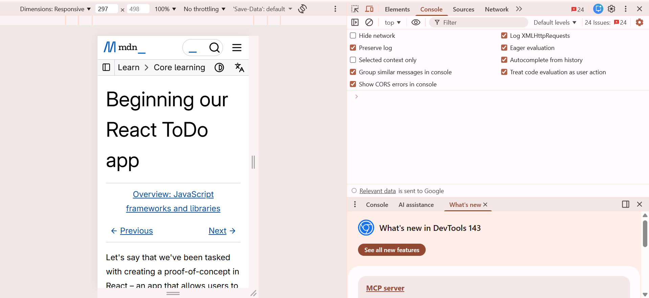
USING THE BROWSER CONSOLE.

Slide 9
USING THE BROWSER CONSOLE
The photo above outlines chrome dev tools which are built in browser tools for inspecting, debugging and analysing websites accessed by CTRL+SHIFT+I, CTRL+SHIFT+J or the one that I really prefer F12.
You can also acces it by write clicking on your browser and clicking on inspect.
The console window is used by developers to log what is going and do some debugging.

Slide 10
USING THE CONSOLE WINDOW
Core Features (Browser DevTools)
Elements/Inspector: View, edit, and debug HTML structure (DOM) and CSS styling in real-time.
Console: Run JavaScript, view logs, errors, and warnings; now features AI for code suggestions and analysis.
Sources/Debugger: Set breakpoints, step through code, and inspect variables for JavaScript debugging.
Network: Monitor HTTP requests/responses, analyze loading times, and throttle connections to simulate slow networks.
Performance: Record and analyze page load and runtime performance, identify bottlenecks, and track memory usage.
Application: Inspect stored data (cookies, local storage), service workers, and other application resources.

Slide 11
USING THE CONSOLE WINDOW
In conole tab you can input this:
console.log(“Hello world, welcome to the Immortal Connect Ecosystem”)
Incase of an uncaght syntax error in your console simply change your opening and closing tags.. In short dont copy paste the code into your console tab. Simply Type it out.

Slide 12
ADDING JAVA SCRIPT TO A WEBPAGE
<html>
<script>
alert(“Hello world this is Java Script with Immortal Connect Technologies”)
</script>
</html
N/B We assume that you know html and creating files in vs code if not reach out to the admin of Immortal Connect.
This is adding Java script directly in html (internal java script or inline java script.

Slide 13
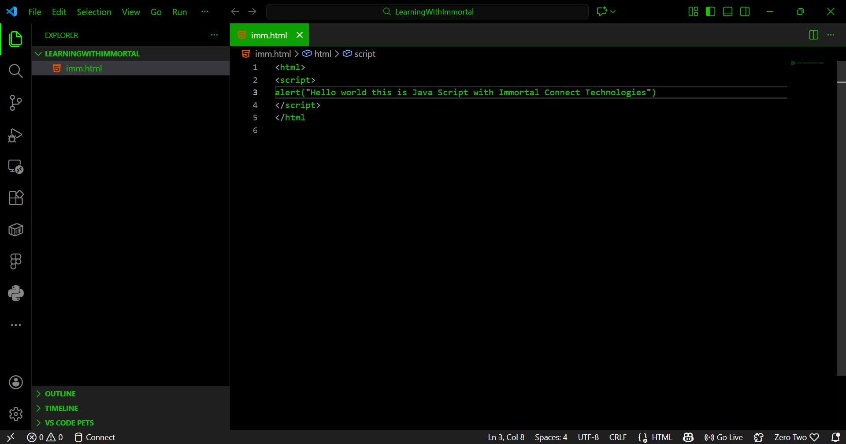
ADDING JAVA SCRIPT TO A WEBPAGE
If you store the above code as imm.html and open the file on your browser it will bring a popup message.

Slide 14
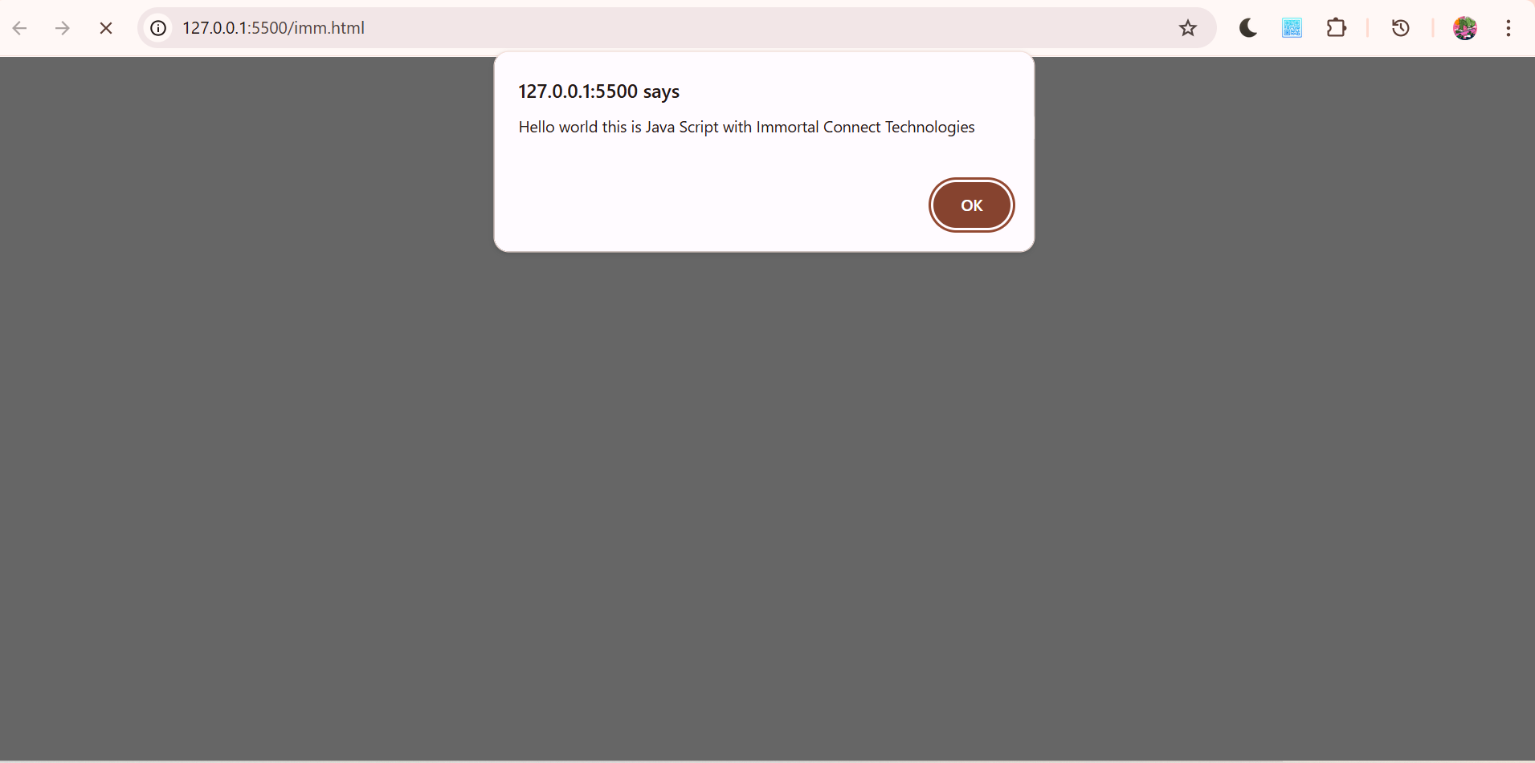
ADDING JAVA SCRIPT TO A WEBPAGE
And Voila.

Slide 15
ADDING JAVA SCRIPT TO A WEBPAGE
There mistakes in our code.
Number one we need to add a body and header tag to our html.
Inline Java Script is not ideal and external java script is preferred.
Tip! you dont have to Hard code html just SHIFT+!+TAB or ENTER an emmet abbreviation to generate a HTML Boilerplate code.

Slide 16
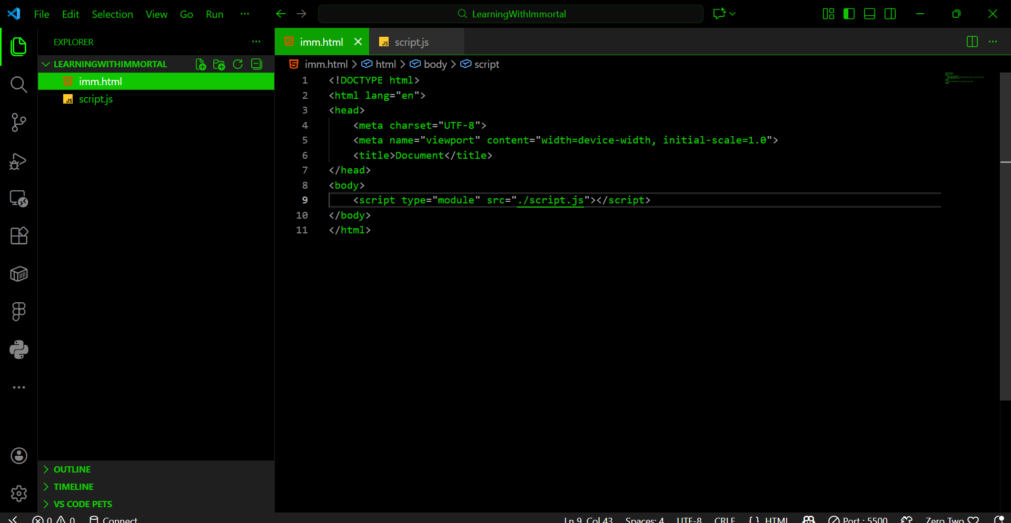
ADDING JAVA SCRIPT TO A WEBPAGE
How its done.

Slide 17
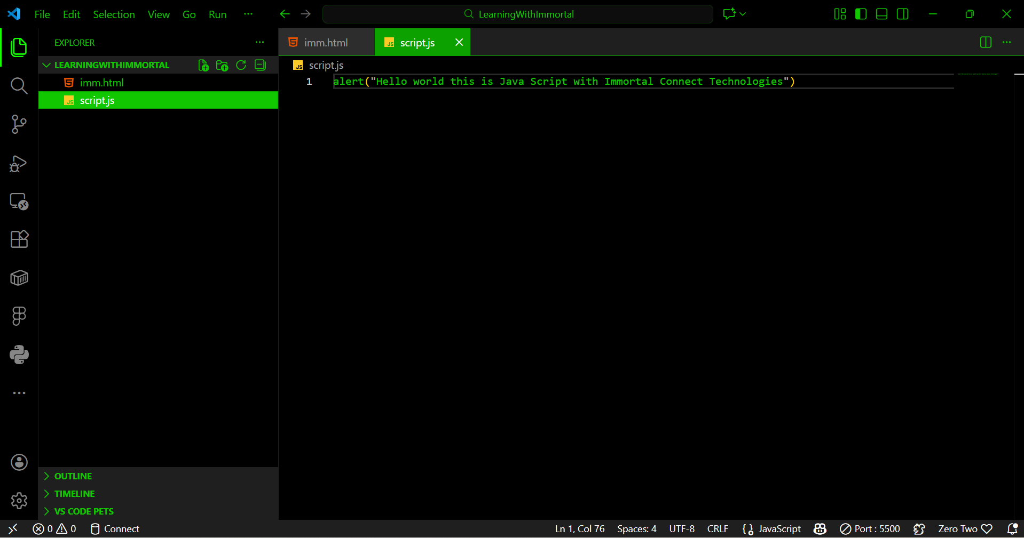
ADDING JAVA SCRIPT TO A WEBPAGE
Step two.

Slide 18
ADDING JAVA SCRIPT TO A WEBPAGE
Importance of linking a JS files externally.
It eliminates lengthy HTML files.
It enables you to reuse the js code on other parts of your website without copy pasting you can just link the file.

Slide 19
ADDING JAVA SCRIPT TO A WEBPAGE
Additional Tips.
Make sure that you put the files in the same Location or you specify the PATH to your Java Script File in your HTML.
You have two options relative and absolute paths.
Relative File Paths
Relative file paths are paths that link to a local file in the same folder or on the same server. For example:
./about.html
./style.css
./images/logo.png

Slide 20
ADDING JAVA SCRIPT TO A WEBPAGE
Key Notations for Relative Paths
The following notations are used to navigate the file system relative to the current file:
./ : Refers to the current directory (folder). In HTML, src="script.js" is equivalent to src="./script.js". In modern JavaScript modules (ESM), the ./ prefix is often required to distinguish local files from library modules.
../ : Moves up one directory level (to the parent folder). You can chain these (e.g., ../../) to move up multiple levels.
No prefix (e.g., images/logo.png) : This is also relative to the current directory. It tells the browser to look for a folder named images inside the current folder.
/ (leading slash) : This is a root-relative path (or path-relative URL), not a purely relative path. It points to the root directory of the entire website (domain).

Slide 21
ADDING JAVA SCRIPT TO A WEBPAGE
An absolute path is a complete, unambiguous address for a file or directory, starting from the root of the file system (like / in Linux or C:\ in Windows) or the web server, and listing every folder step to the final destination, ensuring it works regardless of your current location. It's crucial for scripts and web links that need to consistently find resources, contrasting with relative paths, which only describe the location from the current folder.

Slide 22
ADDING JAVA SCRIPT TO A WEBPAGE
Key Characteristics
Starts from the Root: Always begins at the highest level of the directory structure.
Complete & Unambiguous: Provides the full, exact location, making it reliable.
Local Examples:
  Linux/macOS: /home/user/documents/report.txt
  Windows: C:\Users\user\Documents\report.txt
Web Examples (Absolute URLs): https://www.example.com/images/logo.png (includes protocol & domain).
When to Use Them
Web Development: For linking to external sites or resources that must be found from anywhere on the web.
Scripts & Applications: When a program needs to find a specific file reliably, no matter where the script is run from.
How it Differs from Relative Paths
Absolute: C:\Users\Me\Project\image.jpg (always points to the same place).
Relative: image.jpg (if you're in C:\Users\Me\Project) or ../images/image.jpg (if you're in C:\Users\Me\Project\Subfolder).

Slide 23
ADDING JAVA SCRIPT TO A WEBPAGE
As a rule of thumb always use relative path.
Reason: Using relative paths in HTML offers significant advantages in portability, flexibility, and maintainability for internal links, especially when managing a project across different environments (e.g., local computer, staging server, and production server).

Slide 24
ADDING JAVA SCRIPT TO A WEBPAGE
Advantages of Relative Paths
Portability: The primary advantage is that relative paths make your project self-contained and easy to move. If you transfer your entire website from a local development machine to a web server, or change your domain name, all your relative links will remain functional because they reference files based on their position relative to the current file, not a fixed domain or root directory.
Environment Flexibility: Relative paths work seamlessly in different development environments (like testing on your local machine using the file:// protocol) where an absolute path starting with a domain name (https://www.example.com/...) would break.
Easier Testing: You can test your website files locally in a browser without needing a full server setup or network connection, as the links don't depend on a specific hostname.
Cleaner Code: Relative paths are generally shorter than full absolute URLs, which can result in slightly cleaner, more concise HTML code that is easier to manage and maintain.
Protection Against Scraping (Partial): Using relative paths for internal links can make it slightly more difficult for basic website scrapers to create functional copies of your site, as the copied links would still point back to your original domain (though a sophisticated scraper could adapt).
When to Use Absolute Paths
While relative paths are generally preferred for internal links, you must use absolute paths when linking to resources on:
External Websites: When linking to content or assets on a different domain entirely, you need the complete, fixed address (e.g., www.google.com).
Specific, Unchanging Locations: If a link must resolve to a fixed location regardless of the current page's position in the file hierarchy (which can also be achieved with root-relative paths, e.g., /images/logo.png), absolute paths provide an explicit guarantee.
In summary, best practice for linking files within your own project is to use relative paths for maximum portability and ease of development.

Slide 25
Writing Java Script Code.
Things to keep in mind when writing js code.
Formatting the code, using the right indentation, using semi colons and using comments.
Formatting. Code needs to be formatted to enhance readability.
Key things to conside when formatting are - semi colons and indentations.

Slide 26
Writing Java Script Code.
Indentation and White Space.
When writing code often a line of code belongs to a certain code block.
This code is usually between curly brackets. {} or parent statement.
It is necessary to give your code some indentation to know what is part of the block and where a new block starts.

Slide 27
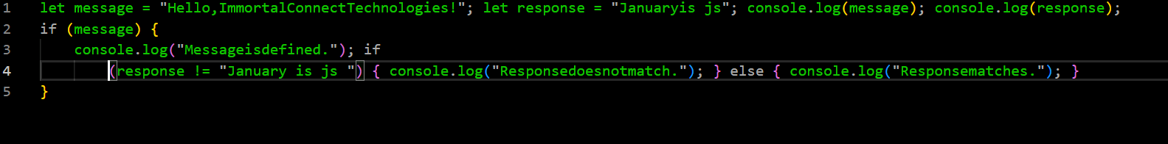
Code without new lines.

Slide 28
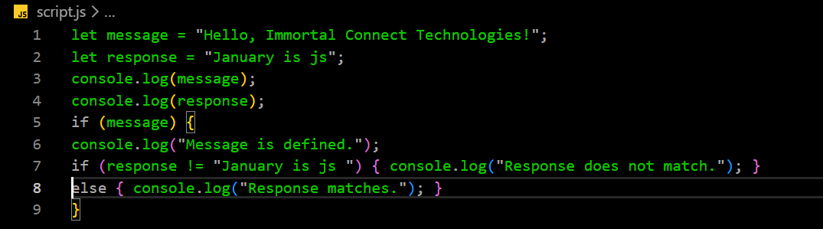
Code with new lines but no indentation.

Slide 29
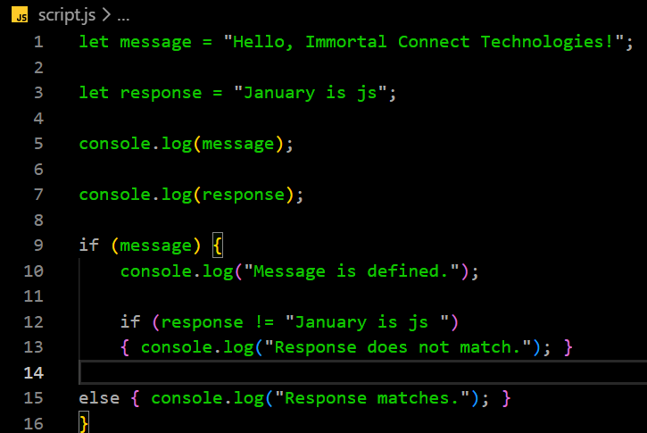
Writing Java Script Code.
Code with indentations and new lines.

Slide 30
To be continued
Thank you.
Copyright: Immortal Connect Technologies
2026
jj

